Slide 1
Machine Learning Model for Stock Investment
Mert Dil
mertdill@outlook.com
Notes:
Machine Learning Overview: Machine learning is a subfield of artificial intelligence that uses algorithms to learn patterns and relationships from data to make predictions or decisions.
Importance of Machine Learning in Finance: Machine learning has revolutionized the financial industry by enabling accurate predictions for stock investments, fraud detection, risk assessment, and personalized recommendations for customers.
Goal of the Project: The goal of this project is to use machine learning algorithms to predict profitable stock investments based on historical financial data.
Dataset Description: The dataset used in this project contains information about the stock market, including stock prices, financial ratios, news sentiment, and economic indicators.
Machine Learning Approach: A supervised learning approach will be used to train a machine learning model to predict whether a stock is a profitable investment or not based on the input features.

Slide 2
Proglem Statement
Objective: To provide an overview of using machine learning techniques for predicting profitable stock investments.
Importance: Stock investment is a crucial part of many people's financial planning, and machine learning can provide valuable insights and predictions to help make informed investment decisions.
Agenda: The presentation will cover the problem statement, data collection and preparation, machine learning model, model evaluation, results, and conclusion.
DATASET DESCRIPTION The data contains the following columns:
Date: Date Open: Opening price of the stock High : Highest value of the stock Low: Lowest value of the stock Close: Closing value of the stock Adj Close: Adjusted closing value of the stock Volume: Volume of exchange for the stock

Slide 3
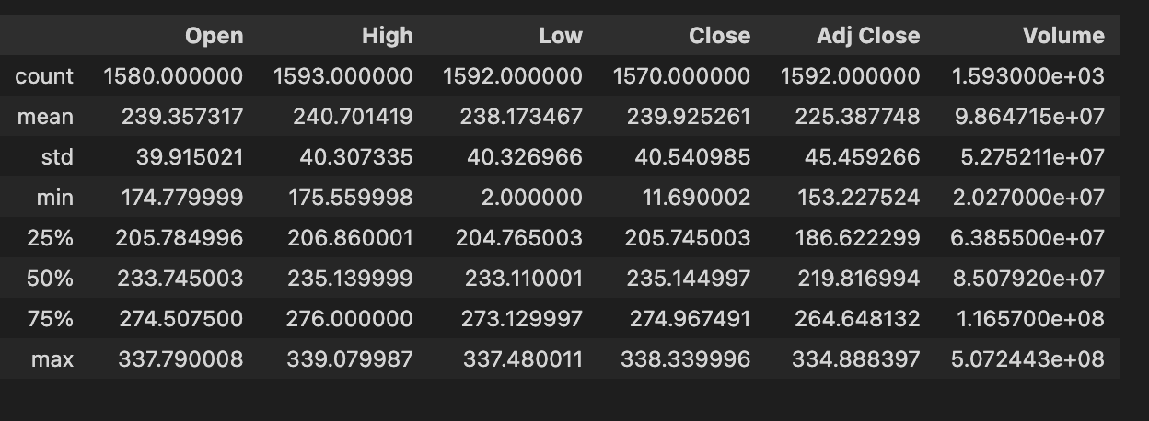
Data Collection
Problem: The challenge of predicting profitable stock investments in a single day.
Background: Traditional methods of stock investment analysis rely on historical data, fundamental analysis, and technical analysis. However, these methods are often time-consuming and cannot account for sudden market fluctuations or unexpected events.
Solution: Use machine learning to build a predictive model that can analyze real-time data and make investment recommendations in a short period of time.
Scope: The model will focus on predicting the performance of individual stocks, rather than entire markets or indices.

Slide 4
Data Preparation
Data Sources: The model will use real-time stock market data from a reliable financial data provider.
Data Collection: The data will be collected and stored in a structured format in a database or file system.
Data Preparation: The collected data will undergo various preprocessing steps such as cleaning, feature engineering, normalization, and scaling to ensure it is suitable for use in the machine learning model.
Feature Selection: The most relevant features will be selected to reduce the dimensionality of the dataset and improve model performance.
Splitting the Data: The dataset will be split into training, validation, and testing sets to enable model training and evaluation.

Slide 5
Machine Learning Model
Model Overview: The XGBoost classifier is a powerful and popular algorithm that uses decision trees to create an ensemble model that can make accurate predictions.
Training the Model: The XGBoost classifier will be trained on the prepared dataset using a supervised learning approach to learn the underlying patterns and relationships between the input features and the target variable.
Hyperparameter Tuning: The hyperparameters of the XGBoost classifier will be optimized using grid search or random search to improve its performance on the validation set.
Model Interpretation: The XGBoost classifier provides interpretable results that can be used to gain insights into the factors that influence profitable stock investments.
Deployment: The trained XGBoost classifier will be
deployed in a real-time stock investment system that can make investment recommendations based on the model's predictions.

Slide 6
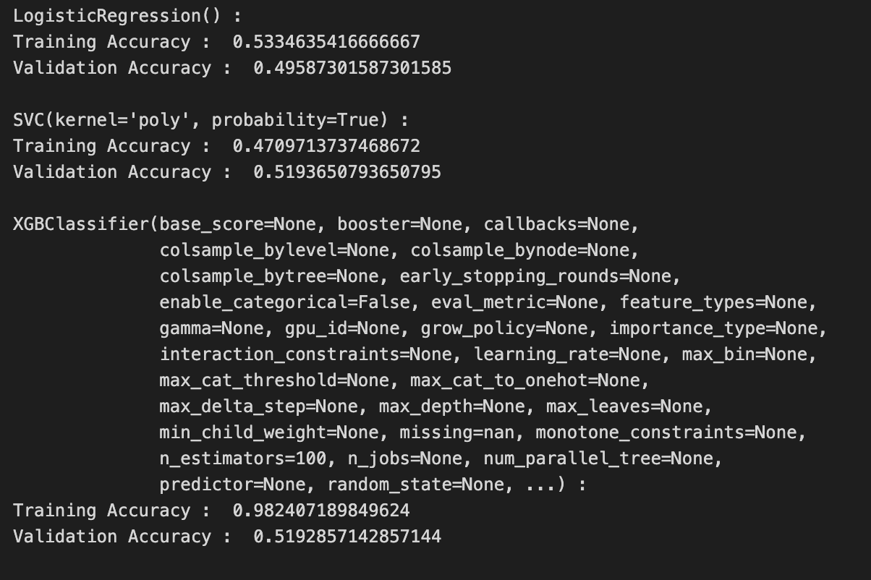
Results
Model Performance Metrics: The XGBoost classifier will be evaluated based on various performance metrics such as accuracy, precision, recall, and F1-score.
Confusion Matrix: The confusion matrix will be used to visualize the number of correct and incorrect predictions made by the XGBoost classifier.
Cross-Validation: K-fold cross-validation will be used to assess the model's ability to generalize to new data and avoid overfitting.
Feature Importance: The XGBoost classifier will provide feature importance scores that can be used to identify the most important features for predicting profitable stock investments.
Comparison with Baseline: The performance of the XGBoost classifier will be compared with a baseline model to assess its effectiveness in predicting profitable stock investments.

Slide 7
Conclusion
Comparison with Other Models: The performance of the XGBoost classifier will be compared with other popular machine learning algorithms such as Random Forest, Logistic Regression, and Support Vector Machines.
Performance Metrics: The comparison will be based on various performance metrics such as accuracy, precision, recall, F1-score, and AUC-ROC.
Interpretability: The interpretability of the XGBoost classifier will be compared with other models to assess their ability to provide insights into profitable stock investments.
Scalability: The scalability of the XGBoost classifier will be compared with other models to evaluate their ability to handle large datasets and real-time processing.
Trade-off Analysis: A trade-off analysis will be performed to identify the best-performing model based on its performance, interpretability, and scalability for predicting profitable stock investments.

